Slide 1



Slide 2

Mobile Price Classification Using Decision Tree Classifier
The study employs a Decision Tree Classifier to build a predictive model using a dataset of 2000 mobile phones with 21 variables. Key aspects include data preprocessing, noise treatment, feature selection, hyperparameter tuning, and model evaluation. The final model achieved an accuracy of approximately 89% on the test data, demonstrating its effectiveness in handling noisy data and making accurate predictions.

Slide 3

Dataset Overview and Preprocessing
The dataset contains information from 2000 mobile phones, with 20 independent variables and 1 dependent variable (price_range). Data preprocessing involved duplicate value detection, missing value detection, and noise detection. Notably, px_height (Pixel Resolution Height) and sc_w (Screen Width) contained many zero or near-zero values, which were identified as potential noise.
1
Variable Identification
Categorize 8 categorical and 13 numeric variables
2
Duplicate value detection
No duplicate values found
3
Missing value detection
There is no missing value in the dataset
4
Noise detection
Identify potential noise in px_height and sc_w variables

Slide 4
Feature Selection Techniques
Feature selection is crucial for improving model performance by selecting relevant features and ignoring irrelevant or redundant ones. This process can enhance model accuracy, reduce overfitting, and improve interpretability. Three main techniques were employed: filter methods (e.g., Pearson correlation coefficient), wrapper methods (e.g., Drop-column Feature Importance), and embedded methods
Filter Methods
Wrapper Methods
Embedded Methods
Use statistical measures to rank features based on correlation with the target variable
Evaluate model performance on different feature subsets
Incorporate feature selection as part of the model training process

Slide 5




Decision Tree Classifier
The Decision Tree Classifier is a supervised machine learning algorithm that uses a tree-like model of decisions and their consequences. It works by recursively splitting the data into subsets based on feature values, aiming to minimize criteria like Gini impurity or entropy. Advantages include easy interpretation, handling of both numerical and categorical data, and ability to manage nonlinear relationships. However, it is prone to overfitting and can be unstable with small data variations.
Working Principle
1
Recursive data splitting based on feature values to minimize impurity
2
Advantages
Easy interpretation, handles various data types, manages nonlinear relationships
Disadvantages
3
Overfitting prone, unstable with data variations, poor complex function approximation

Slide 6
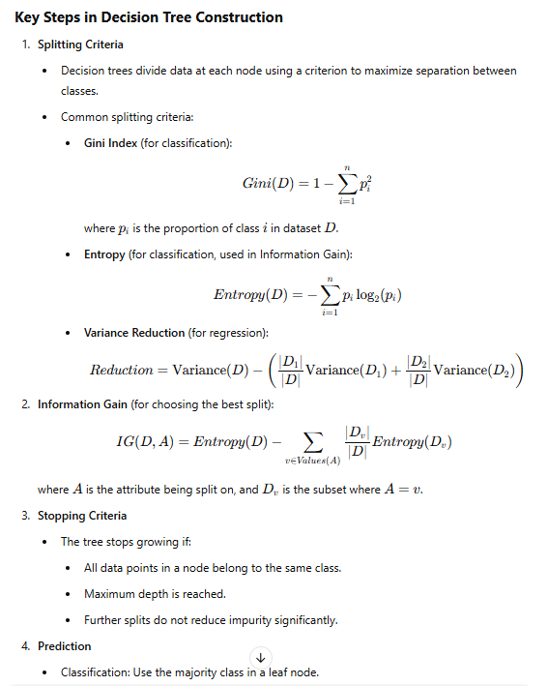

Slide 7





Noise Treatment with KNN Imputer
To address the noise sensitivity of the Decision Tree algorithm, KNN Imputer was employed for noise treatment. This technique imputes missing or noisy values by finding the k-nearest neighbors of a data point and using the average of those neighbors. This approach was particularly useful for handling the noise detected in px_height and sc_w variables .
Identify Noisy Data
Apply KNN Imputer
Impute Values
Clean Dataset
Detect noise in px_height and sc_w variables
Find k-nearest neighbors for noisy data points
Replace noisy values with average of nearest neighbors
Obtain noise-treated dataset for model training

Slide 8





Hyperparameter Tuning
Hyperparameter tuning is crucial for decision trees to prevent overfitting. The process involves adjusting parameters such as criterion, maximum depth, minimum samples per split, minimum samples per leaf, and maximum features. These parameters control the tree's complexity and help balance between underfitting and overfitting. Techniques like pruning and ensemble methods can also be used to prevent overfitting in decision trees.
Maximum Depth
Minimum Samples per Split
Controls the maximum depth of the tree to limit complexity
Sets the minimum number of samples required to split a node
Minimum Samples per Leaf
Maximum Features
Determines the minimum number of samples required for a leaf node
Limits the number of features considered when splitting a node

Slide 9

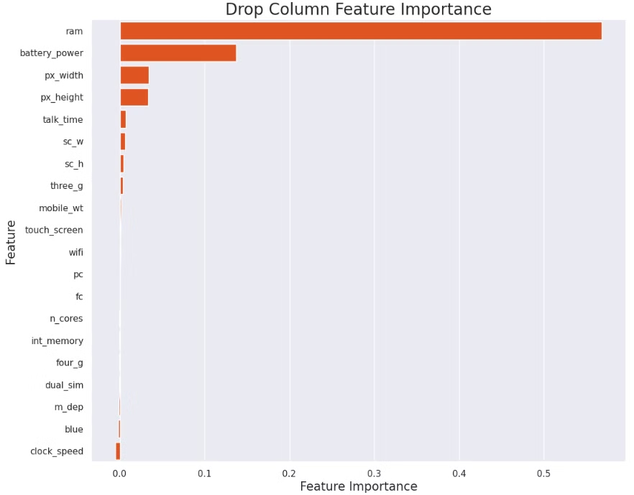
Feature Subset Selection
Feature subset selection was performed to simplify the decision tree and reduce its complexity. The Drop-column Feature Importance technique was used to detect redundant features. This process involved removing irrelevant features from the dataset, which can lead to improved model accuracy by reducing overfitting. The technique evaluates the importance of each feature by measuring the impact of its removal on the model's performance.
Feature
Importance Score
RAM
High
Battery Power
Medium
Internal Memory
Medium
Screen Size
Low

Slide 10
Model Evaluation and Conclusion
The final Decision Tree model, with optimized hyperparameters, achieved an accuracy of approximately 96% on the training data and 89% on the test data. The slight decrease in accuracy on the test data suggests mild overfitting, which was addressed by adjusting the max_depth parameter. This project successfully developed a noise-resilient Decision Tree Classifier for predicting mobile phone price ranges based on key specifications. By effectively handling noisy data, selecting relevant features, and tuning hyperparameters, the model achieved high accuracy while maintaining simplicity and interpretability.
1
Training Accuracy
2
Test Accuracy
96% accuracy achieved on the training dataset
89% accuracy achieved on the test dataset
3
Overfitting Mitigation
Addressed mild overfitting by adjusting max_depth parameter

